Slide 1
Synthetic Fraud Detection Using Generative Modeling and Anomaly Detection in Spain
Report by Marcio Vilariño
Notes:
Objetivo del proyecto
En este proyecto, elegirás un escenario, recopilarás datos de referencia para él y usarás Microsoft Copilot para complementar o ampliar tus datos. Después, aplicarás tus datos a una tarea de análisis de datos. Finalmente, elaborarás un informe técnico que evaluará las soluciones de IA Generativa (GenAI) para tareas específicas de ciencia de datos, abordando las cuestiones de seguridad y privacidad de los datos.
Escenario del proyecto
Comencemos con el contexto. Imagina que eres un prometedor científico de datos. Basándote en un escenario elegido, recopilarás tus datos de referencia e integrarás IA generativa de vanguardia en tu flujo de trabajo. Microsoft Copilot, un potente asistente de IA, es la herramienta que utilizarás para optimizar procesos, complementar tus datos y descubrir nuevos conocimientos. Sin embargo, los riesgos potenciales de la IA en la ciencia de datos, como el sesgo, la desinformación y las violaciones de la privacidad de los datos, deben considerarse cuidadosamente y mitigarse. Tu reto es demostrar los beneficios de Copilot y, al mismo tiempo, garantizar un uso ético y responsable de la IA.
Objetivo
Este proyecto tiene como objetivo crear un portafolio completo que demuestre su dominio de Microsoft Copilot en ciencia de datos. Su portafolio debe demostrar su capacidad para:
Utilice Copilot en distintas etapas del proceso de ciencia de datos.
Aplicar modelos de IA generativos (GAN, VAE o Transformers) para resolver problemas de ciencia de datos del mundo real.
Identificar y mitigar los posibles riesgos de seguridad y privacidad de los datos asociados con la IA generativa.
Comunique sus hallazgos, metodología y consideraciones éticas de manera eficaz.

Slide 2
Problem Statement: What factors impact weather a mother will be able to deliver child through natural birth in Spain.

Slide 3
1 a) Generate Synthetic data using Co-pilot to build the model
Here's your synthetic dataset with 1,000 rows for Spain, containing:
Full Name of Mother
Age of Mother
Gender of Child
Ethnicity of Mother
Procedure (Natural Birth or Cesarean)

Slide 4
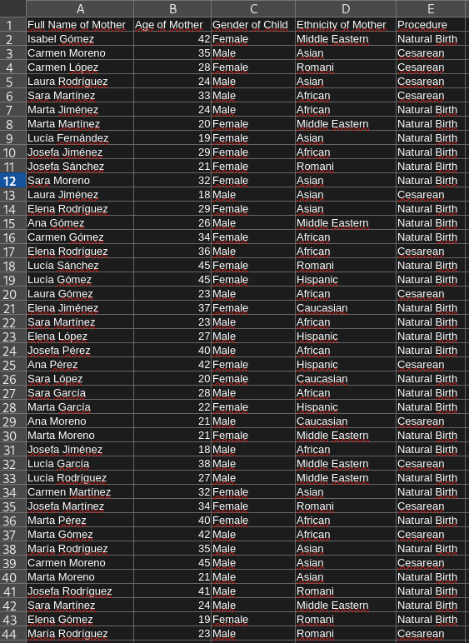
1 b) Results in Excel after running the python script : Top Ten for reference)

Slide 5
2 b) Data analysis using Co-Pilot Web and in Excel
Please evaluate this data and find someone who is more than two standard deviations above or below the age range of 20 to 40 years old.
🧠 Outliers
Mean Age (for 20–40 range): 30.26 years
Standard Deviation: 6.06 years
Lower Bound: 18.13 years
Upper Bound: 42.39 years
Number of Outliers: 138
Lowest Ages:
Laura Jiménez — 18 years old, Male child, Asian, Cesarean
Josefa Jiménez — 18 years old, Male child, African, Natural Birth
Elena Jiménez — 18 years old, Female child, Romani, Natural Birth
Highest Ages:
Lucía Sánchez — 45 years old, Female child, Romani, Natural Birth
Lucía Gómez — 45 years old, Female child, Hispanic, Natural Birth
Carmen Moreno — 45 years old, Male child, Asian, Cesarean

Slide 6
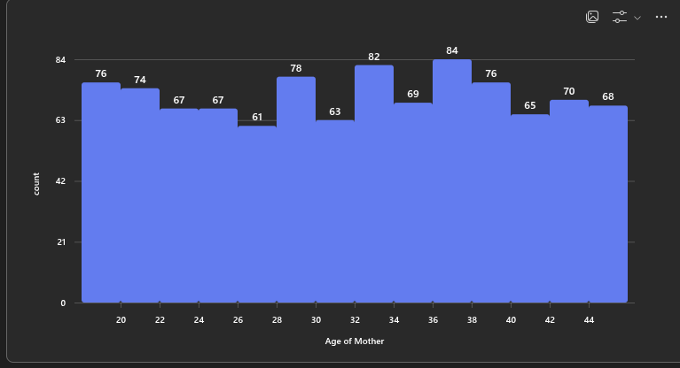
2 a) Data analysis using Co-Pilot Web and in Excel

Slide 7
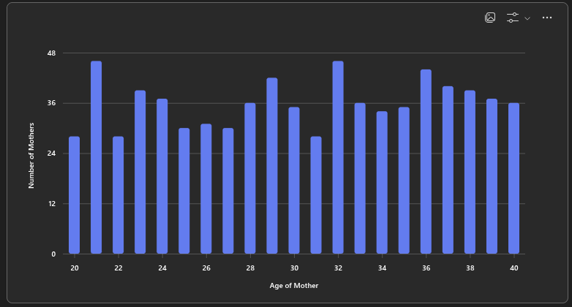
2 c) Data analysis using Co-Pilot Web and in Excel

Slide 8
3 a) Implementing a random forest model
Please help me create a random forest model using my file, which would provide insights that management could leverage to understand current habits and make suggestions for improvements.

Slide 9
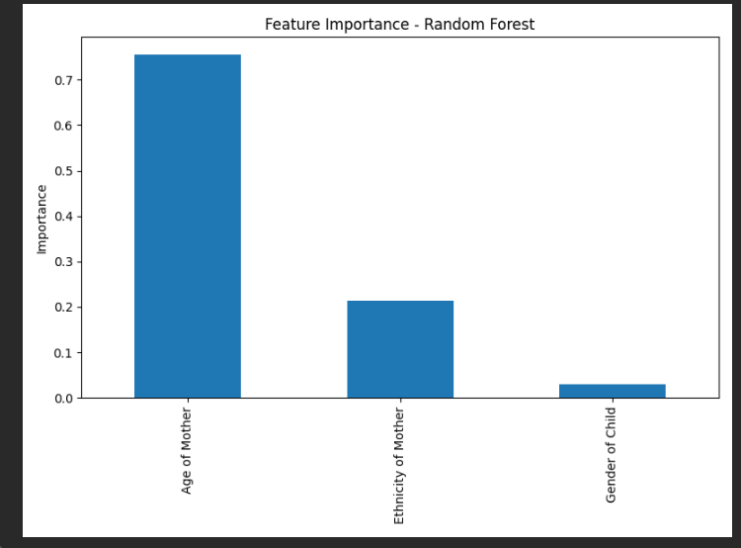
3 b) Implementing a random forest model

Slide 10
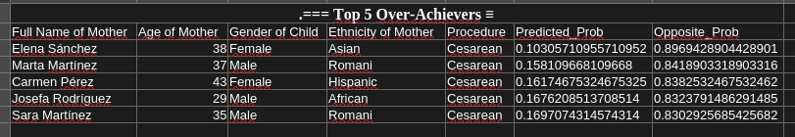
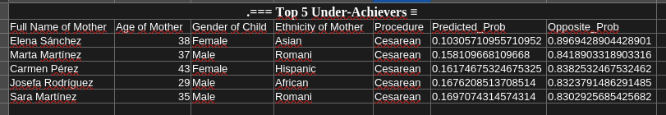
3 c) Implementing a random forest model
Finally I asked Co-pilot to enhance the Python code to show outlers in the model. This returned the following results

Slide 11
4. Considerations for implementing the model with real-life data
Internal Company Policy
Data Governance: Ensure the company has clear policies on data collection, storage, access, and sharing. Only authorized personnel should handle sensitive data.
Data Security: Implement robust security measures (encryption, access controls, audit trails) to protect data from unauthorized access or breaches.
Data Minimization: Use only the data necessary for the model. Avoid collecting or processing unnecessary personal information.
Employee Training: Train staff on data privacy, security protocols, and ethical use of AI models.
Transparency: Inform employees and stakeholders about how data will be used, and the purpose of the model.
Regulatory Considerations
GDPR (General Data Protection Regulation): For data from Spain (or the EU), GDPR applies. Key requirements include:
Lawful Basis: Ensure you have a legal reason for processing personal data (e.g., consent, legitimate interest).
Data Subject Rights: Individuals have rights to access, rectify, erase, and restrict processing of their data.
Data Protection Impact Assessment (DPIA): Required for high-risk processing, such as large-scale use of sensitive data.
Anonymization/Pseudonymization: Remove or mask identifiers (names, etc.) before using data for modeling to reduce privacy risks.
Other Local Laws: Check for additional Spanish or sector-specific regulations (e.g., health data laws).
Data Transfers: If data is transferred outside the EU, ensure appropriate safeguards (Standard Contractual Clauses, adequacy decisions).

Slide 12
5. Findings
Any implementation of such a project would first need however careful consideration against the guidance highlighted in section 2
Providing criteria 1 is met, findings such as those outlined in section 1b could then be used to improve overall participation. For instance “over-achiever” interviews could be conducted to understand qualitatively what has led them to score so highly e.g. supportive management, personal motivation or each of access. Similarly handled sensitively “under achievers” could also be interviewed to determine what could help them to study more e.g. their team work hours are longer than other departments and could be more balanced etc.
Such findings could then for instance be used to start an internal marketing campaign to guide others to increase their participation and overcome barriers..

Slide 13
Project ends here
The rest of the slides were provided in the original analysis provided in the course

Slide 14
Conclusion and Recommendations
Summary
Microsoft Copilot significantly improved productivity and model performance in fraud detection.
Generative AI models effectively supplemented scarce data sources.
Recommendations
Integrate Copilot and generative AI into fraud detection workflows.
Regularly review ethical practices and privacy measures.
Explore additional AI models for improved synthetic data so that there is not more difference between synthetic and Reference data .

Slide 15
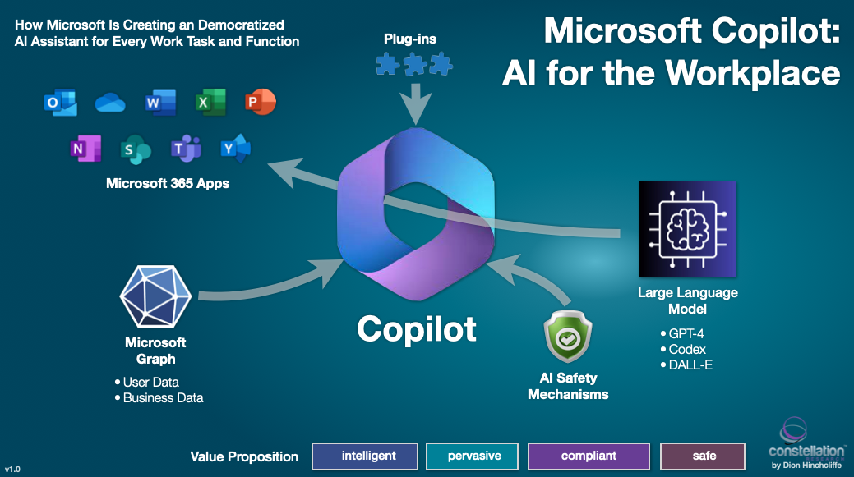
Grading Criteria
Copilot proficiency: How effectively did you use Copilot throughout the project?
Technical knowledge: Do you strongly understand generative AI and data science?
Problem-solving skills: Did you effectively identify challenges and apply AI solutions with Copilot's help?
Ethical awareness: Did you consider and address the potential ethical implications of generative AI? What steps did you take to anonymize data or avoid using sensitive data?
Communication skills: Are your project objectives, methodology, results, and implications communicated in both written and (optional) oral formats?

Slide 16
Using Copilot Across the Data Science Workflow
Data Cleaning: Imputation, outlier removal
Exploration: Summary statistics, visualizations
Feature Engineering: Patterns by time/location
Model Training: Classification and tuning
Interpretation: Feature importance insights

Slide 17
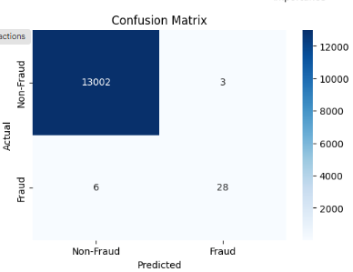
Model Development Workflow
Train baseline Random Forest on real data( baseline model confusion matrix in Figure )
Use GANs to generate synthetic fraud data
Merge synthetic and real data
Train multiple models with GridSearchCV

Slide 18
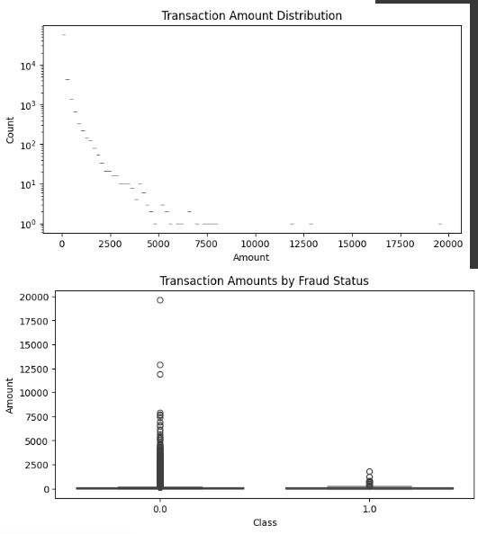
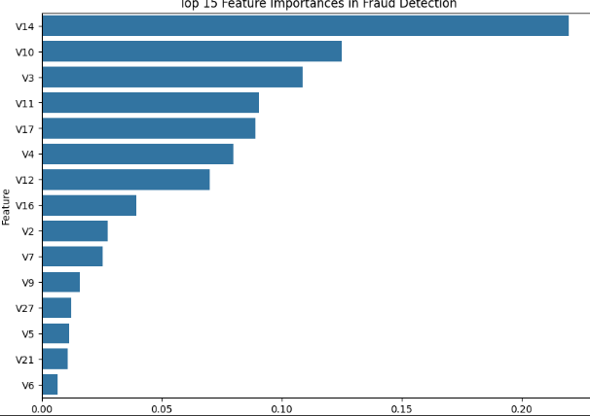
Visualization
Top Plot (Transaction Amount Distribution):
The majority of transactions involve small amounts, as indicated by the high count on the left side of the plot.
There are very few high-value transactions, resulting in a long-tailed, right-skewed distribution.
Bottom Plot (Transaction Amounts by Fraud Status):
Both fraudulent and non-fraudulent transactions are mostly for low amounts, but there are some large outliers in both classes.
High-value transactions are rare and occur in both fraud and non-fraud cases, suggesting amount alone is not a clear fraud indicator.
This horizontal bar chart shows that feature V14 is by far the most important variable in detecting fraud, followed by V10 and V3. The remaining features contribute less, with a sharp drop in importance after the top few features.

Slide 19

Project Objective and Scope
Showcase Microsoft Copilot in a real data science workflow
Use GANs to improve fraud detection with imbalanced data
Address security, privacy, and ethical considerations
Deliver a complete project portfolio

Slide 20
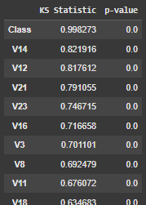
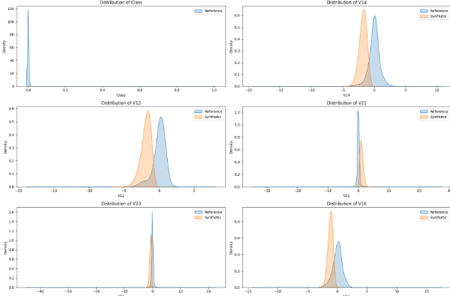
Synthetic Data Validation
Used KS-test to validate distribution match
Preserved key fraud indicators
High KS Statistic values (close to 1), especially for "Class" and V14/V12, indicate significant distribution differences between your real and synthetic data for these features.
Very low p-values (0.0) confirm these differences are statistically significant.
For all features shown, the synthetic data distributions (orange) are similar in shape to the real/reference data (blue), but generally shifted—there are visible differences in means and some spread.
The synthetic data is broadly realistic, but not identical to the real data, especially for the shown features

Slide 21
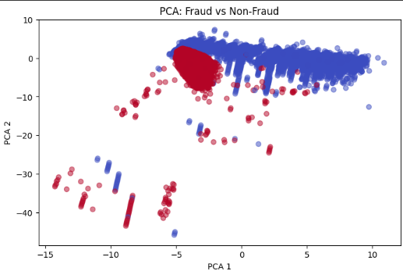
Visualized with PCA: after validation and combined real and synthetic data
The PCA plot shows that fraud (red) and non-fraud (blue) transactions form distinct clusters, with some overlap. This suggests that the main principal components capture meaningful differences between fraudulent and non-fraudulent behavior.

Slide 22
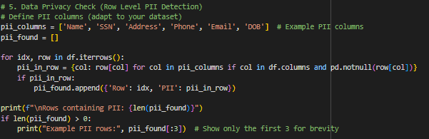
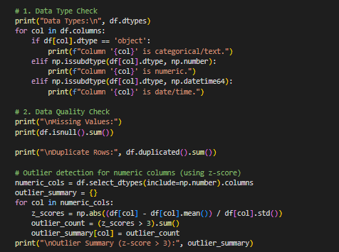
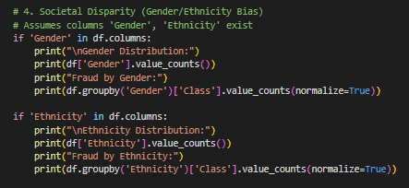
Data Security and Privacy(some copilot generated code in here )
Data Privacy
Anonymized Features: Original dataset uses anonymized variables (V1–V28), reducing PII exposure.
PII Handling: Real-world data must be checked and sanitized for personally identifiable information.
Synthetic ≠ Safe by Default: Poorly generated synthetic data may still leak real patterns — did rigorous validation (e.g., KS test, distributions)
🔒 Data Security( implemented in Full security model )
Secure Storage: Encrypt data, models, and outputs; enforce access control.
Encrypted Model Saving: Notebook uses encrypted model storage via joblib + cryptography.
Audit Logging: Track model access and updates to ensure traceability.
Prevent Data Leakage: Preprocessing done post-split to avoid leakage; improves robustness and privacy.
⚖️ Bias Mitigation
Bias Monitoring: Evaluate model fairness across groups .
Synthetic Bias Risk: GANs trained on biased data may reinforce those biases — inspect and validate outputs.

Slide 23
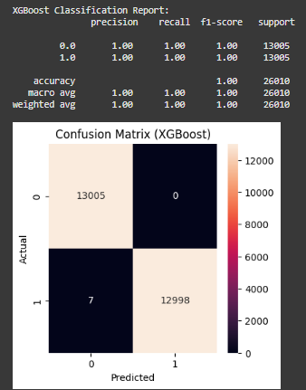
Results and Key Insights
Synthetic data boosted rare fraud detection
Copilot accelerated development
Ethical and privacy risks were managed
The XGBoost model achieved perfect precision, recall, and F1-score for both classes, with only 7 misclassified fraud cases out of 26,010 transactions. The confusion matrix shows almost perfect separation between fraud and non-fraud, indicating outstanding fraud detection performance.

